Slide 1

Revision Hints and Tips
Part 2

Slide 2

https://www.youtube.com/watch?v=wjh10kj9Y64&t=3s

Slide 3

Note-taking

Slide 4
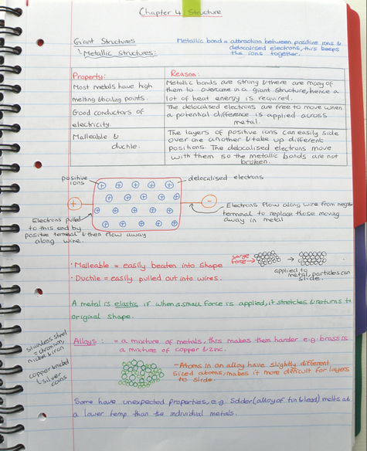
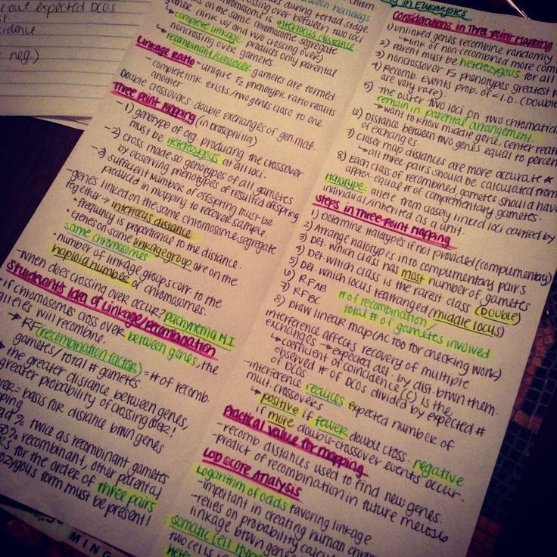

Slide 5


Slide 6


Slide 7
Working environment

Slide 8
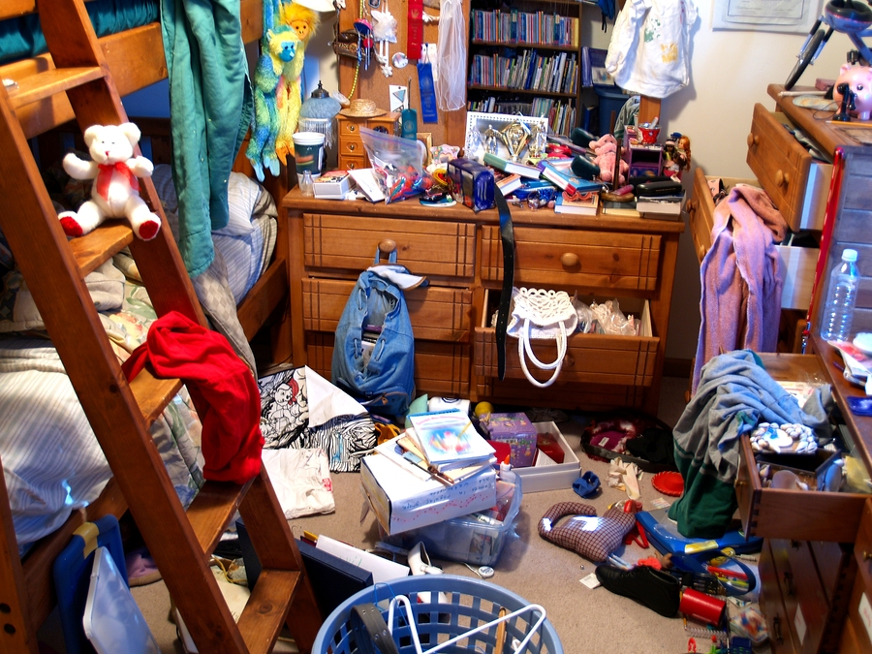

Slide 9


Slide 10
Revision Timetable

Slide 11
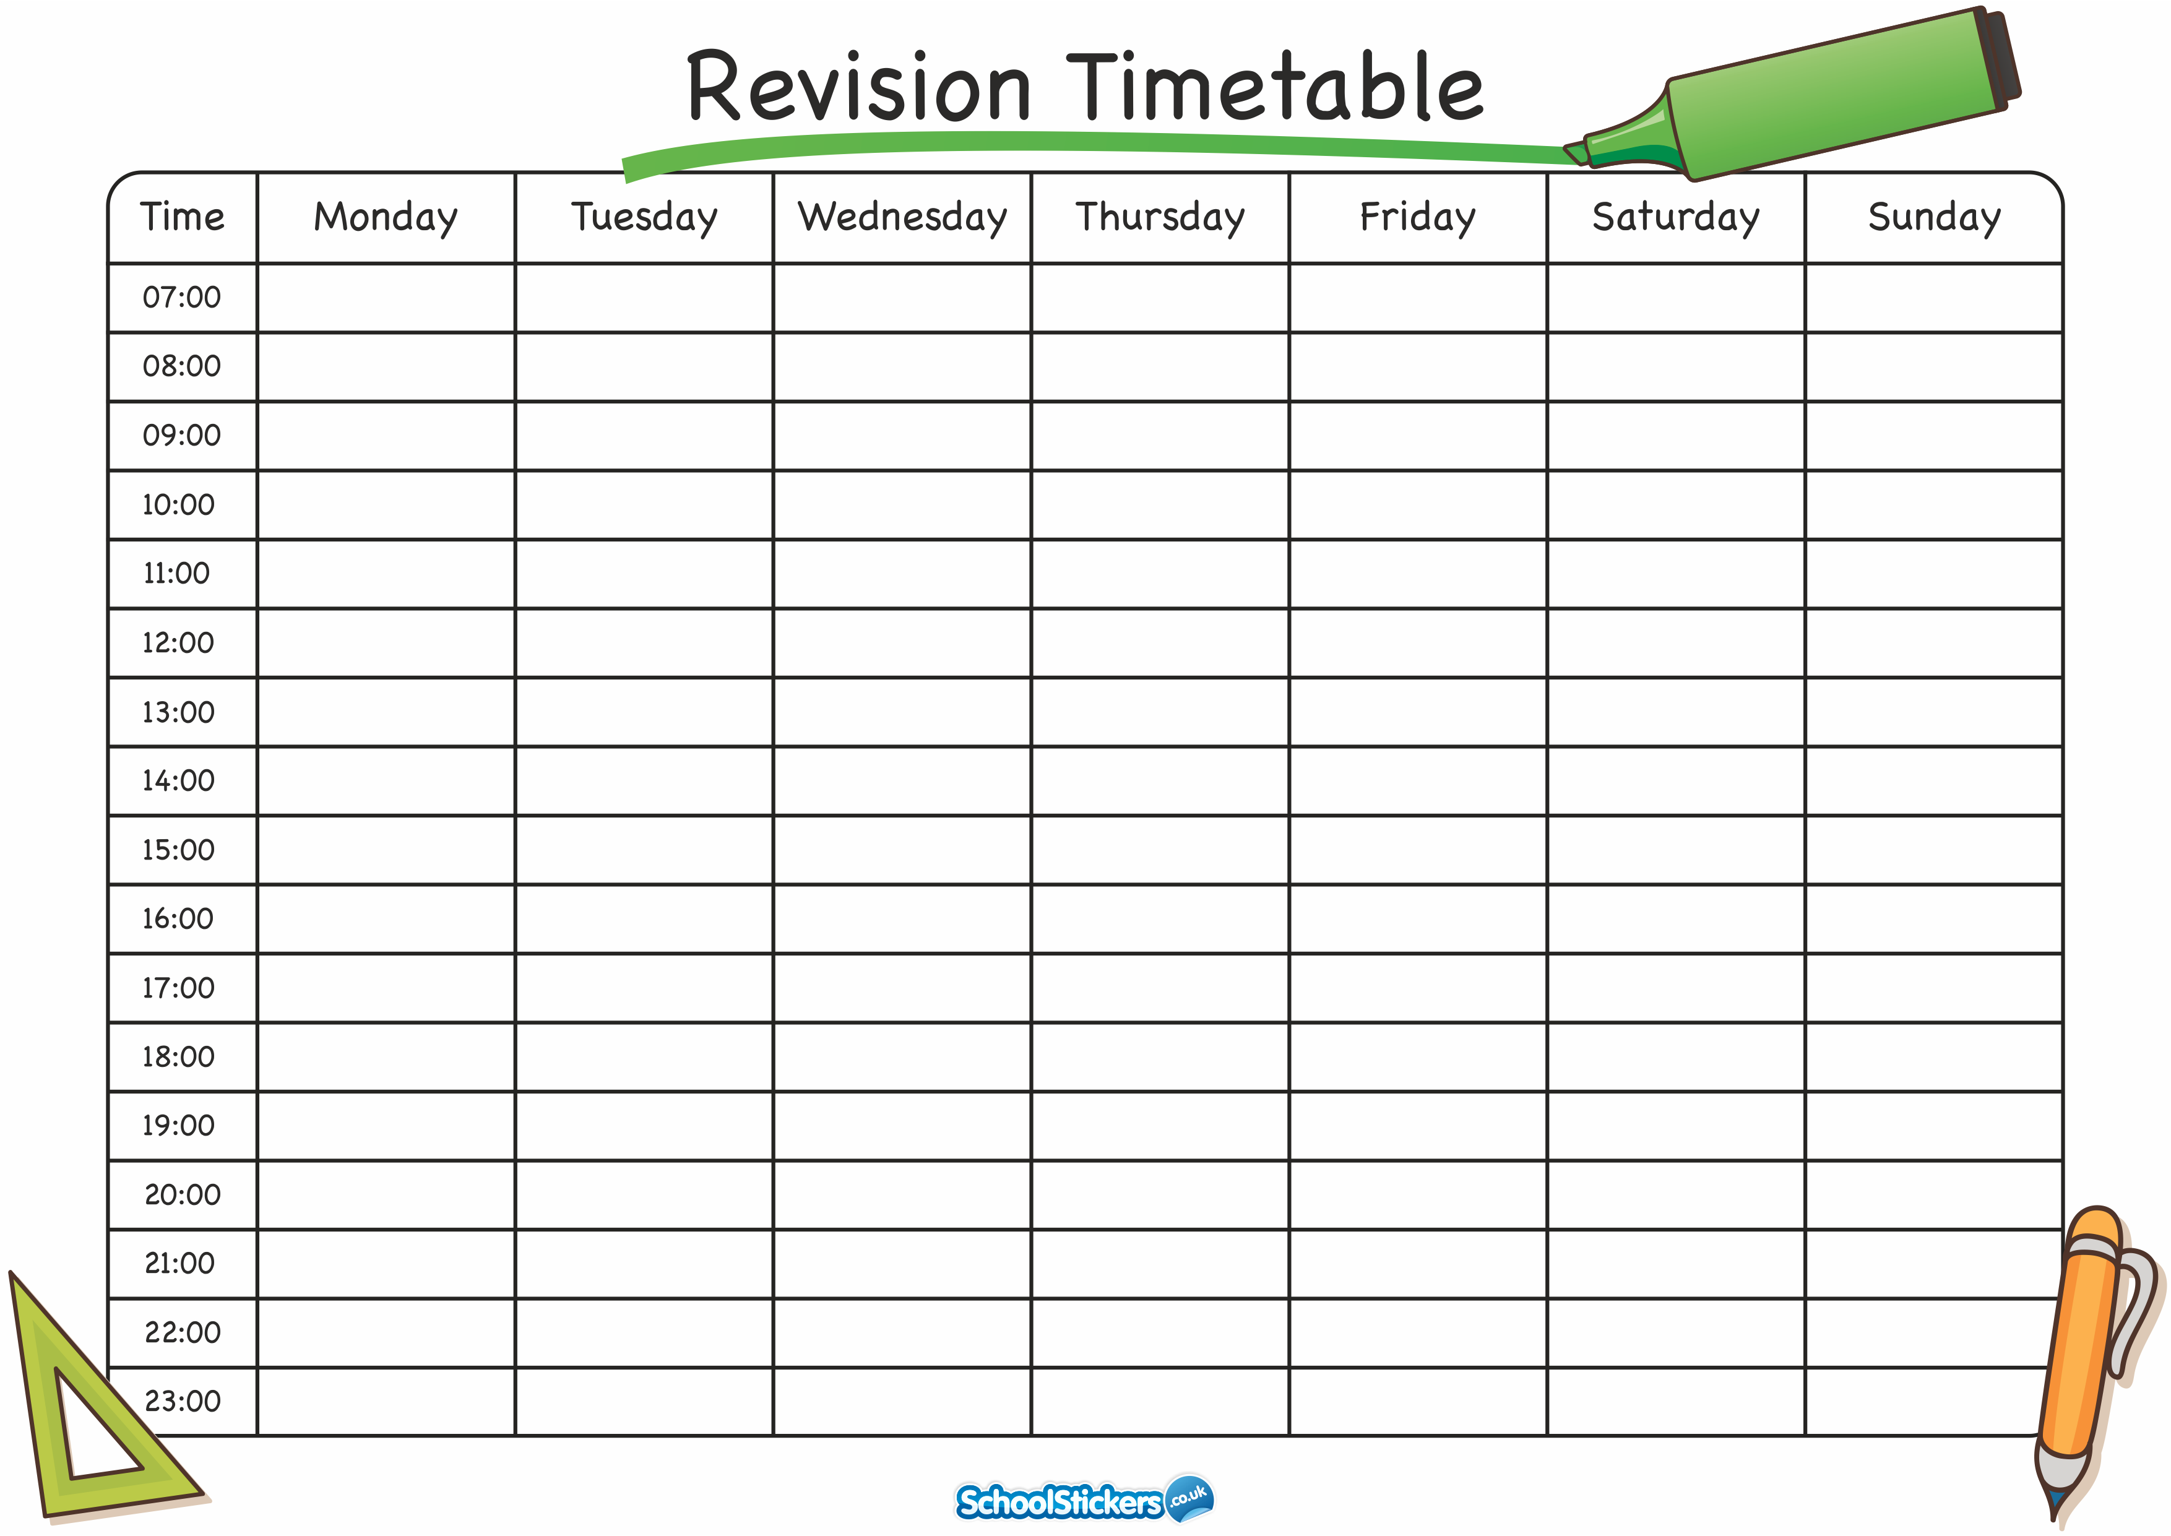

Slide 12
What we offer as a school?
Weekly revision sessions
Easter revision sessions
Help and guidance
A revision support kit
Leavers’ assembly 22nd June

Slide 13


